Slide 1

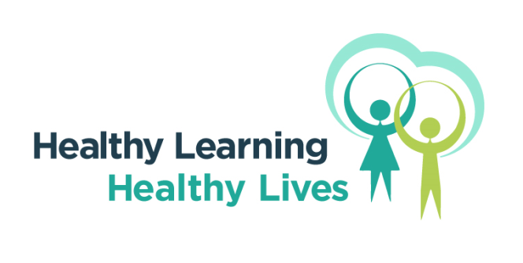
HEALTHY EATING
GREAT TIPS

Slide 2

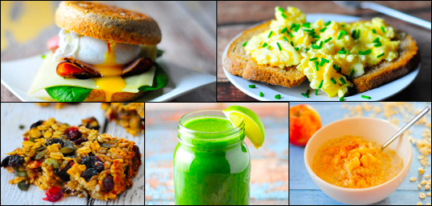
DON’T SKIP BREAKFAST
Skipping meals won't help you lose weight and is not good for you, because you can miss out on important nutrients.
Having breakfast will help you get some of the vitamins and minerals you need for good health.
Notes:
Key message is to eat some breakfast, which ideally is not high in fats or sugar. Beans on wholemeal toast, or scrambled egg on wholemeal toast, or cereals which are high in fibre and low in sugar would be good options. (Cereals – Shredded wheat, porridge, bran flakes, all-bran , no added sugar muesli – would be good suggestions)

Slide 3
GET YOUR 5 A DAY
Fruit and vegetables are good sources of many of the vitamins and minerals your body needs during your teenage years.
Aim to eat at least five portions of a variety of fruit and veg a day
https://www.youtube.com/watch?v=b-uX6N4RZjg
Notes:
Reminder that fruit and vegetables do not have to be fresh, frozen, canned, dried and juice still count. For tinned fruit opt for options without the syrup, and only one small glass of juice is required.
You Tube clip explaining more about portion size

Slide 4
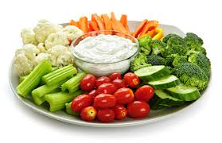
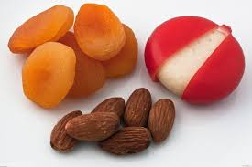
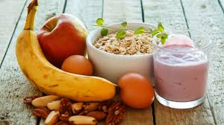
HEALTHIER SNACK IDEAS
Cut down on food and drinks high in fat, sugar and salt, such as sweets, chocolate bars, cakes, biscuits, sugary fizzy drinks and crisps, which are high in calories (energy).
Consuming too many calories can lead to weight gain and becoming overweight. Get tips on eating less sugar, fat and salt.
Notes:
The key message is for snacks to be low sugar, salt and fat. With the emphasis being on fruit and vegetables

Slide 5
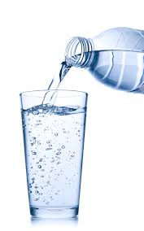
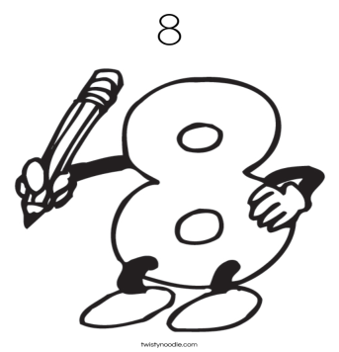
STAY HYDRATED
Aim to drink six to eight glasses of fluids a day – water and lower-fat milk are all healthy choices.
Even unsweetened fruit juice is sugary. Your combined total of drinks from fruit juice, vegetable juice and smoothies should not be more than 150ml a day – which is a small glass.
For example, if you have 150ml of orange juice and 150ml smoothie in one day, you'll have exceeded the recommendation by 150ml.

Slide 6

FEELING TIRED
If you often feel run down, you may be low on iron. Teenage girls are especially at risk because they lose iron during their period.
Try to get your iron from a variety of foods. Some good sources are red meat, breakfast cereals fortified with iron, and bread.

Slide 7
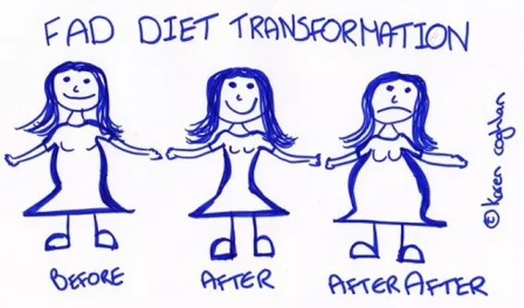
FAD DIETS
Diets that promise quick weight loss are often not nutritionally balanced, meaning you could miss out on important vitamins and minerals.
They also tend to focus on short-term results, so you end up putting the weight back on.

Slide 8
ESSENTIAL VITS & MINS
Vitamin D
Vitamin D helps keep bones and teeth healthy. We get most of our vitamin D from the sun, but it is also available in some foods
Calcium
Calcium helps to build strong bones and teeth. Good sources of calcium include milk and other dairy products, and leafy green vegetables
Iron
Iron is important in making red blood cells, which carry oxygen around the body.
A lack of iron can lead to iron deficiency anaemia.
Notes:
The three main essential vitamins and minerals children are often low on are Iron, Vitamin D and Calcium. You could give some examples of suitable food sources –
Iron - liver (but avoid this during pregnancy)
meat
beans
nuts
dried fruit – such as dried apricots
wholegrains – such as brown rice
fortified breakfast cereals
soybean flour
most dark-green leafy vegetables – such as watercress and curly kale

Slide 9
FOR DISCUSSION……….
Is anything stopping you from eating a healthy diet?
In pairs list some barriers which you feel get in the way

Slide 10
FOR DISCUSSION……….
What could you do to make a difference?
In pairs list some small changes you could make to your daily food and drink routine

Slide 11
WANT TO KNOW MORE?
NHS Choices
http://www.nhs.uk/Livewell/Goodfood/Pages/healthy-eating-teens.aspx
Change for life
https://www.nhs.uk/change4life-beta
British Nutrition Foundation
https://www.nutrition.org.uk/healthyliving/lifestages/teenagers.html?limit=1

